Slide 1
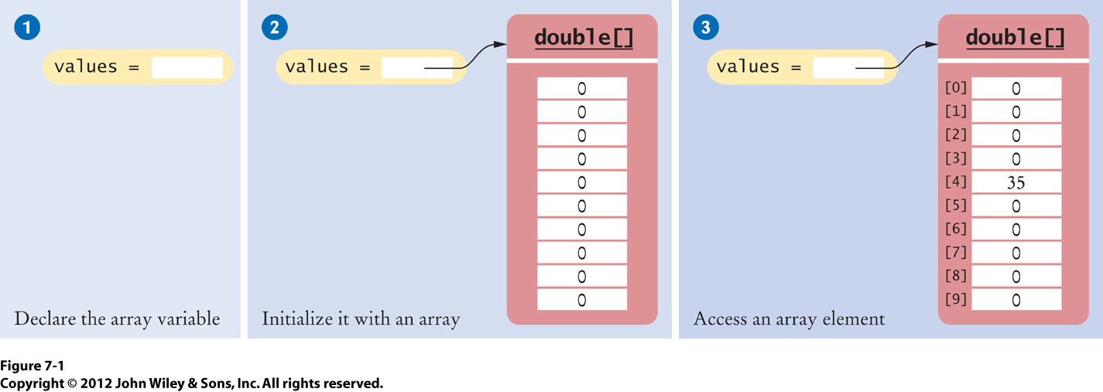
Fig_7-1
Unlike ArrayLists, arrays can hold primitives…

Slide 2
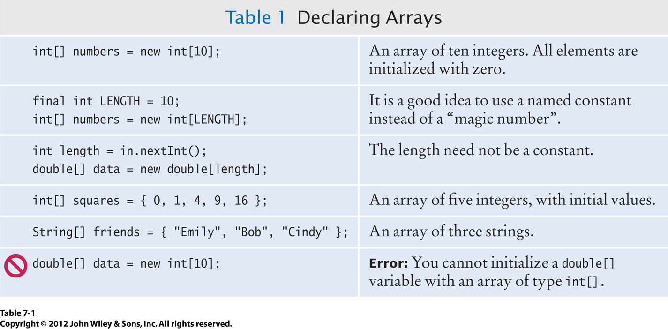
Tab_7-1

Slide 3
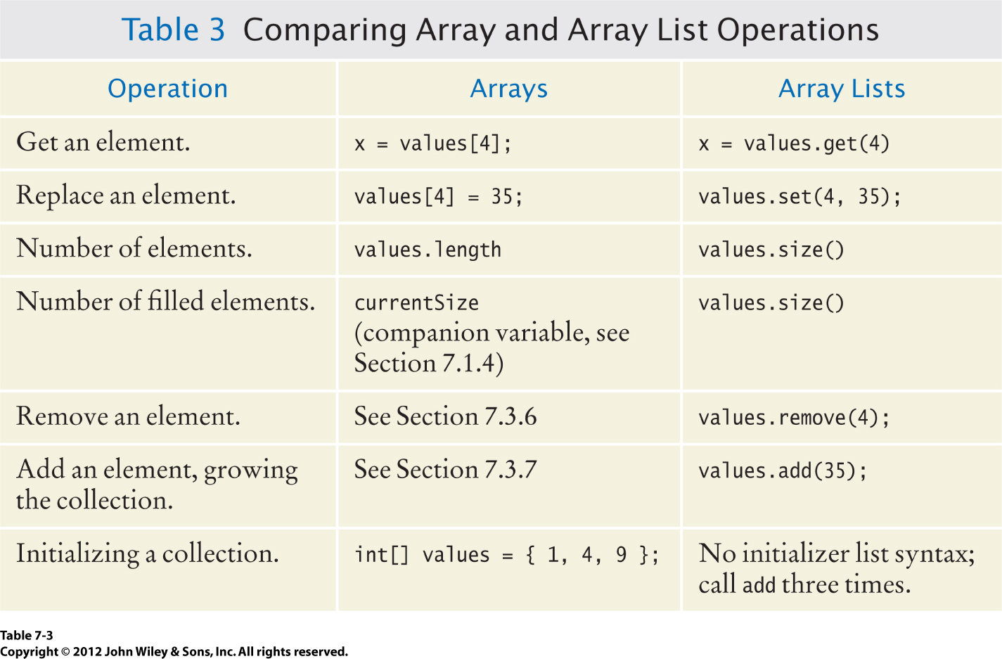
Tab_7-3

Slide 4
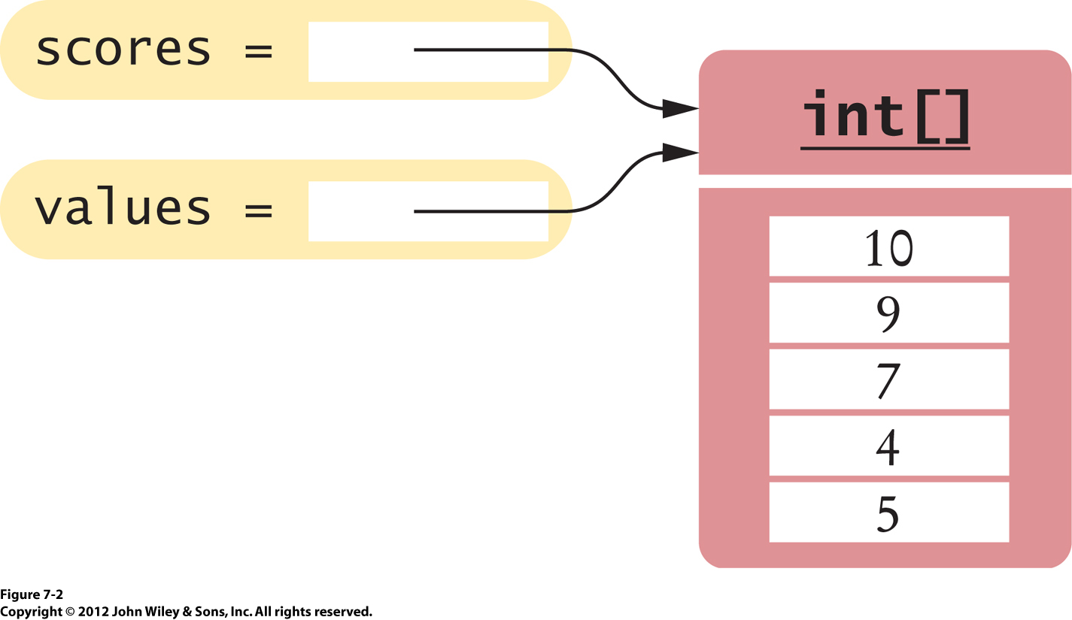
Fig_7-2

Slide 5
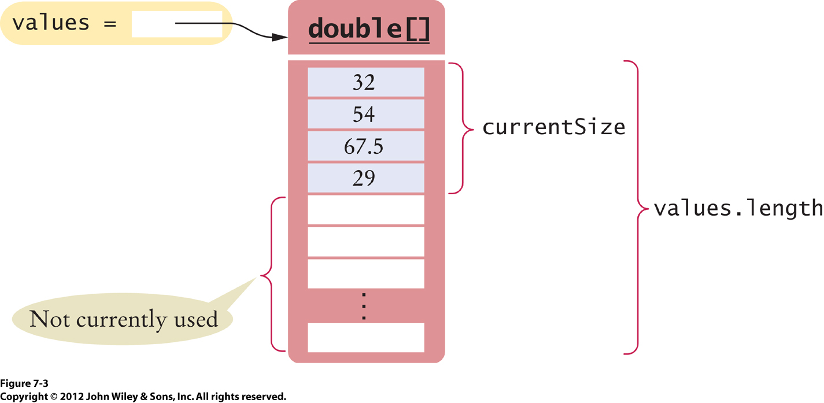
Fig_7-3

Slide 6
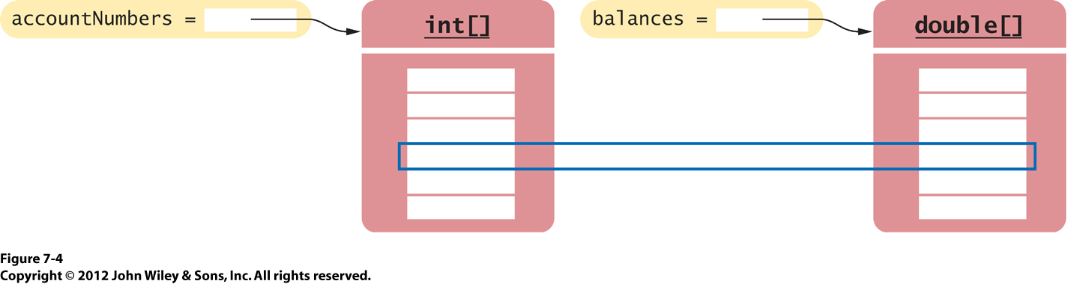
Fig_7-4
Parallel Arrays

Slide 7
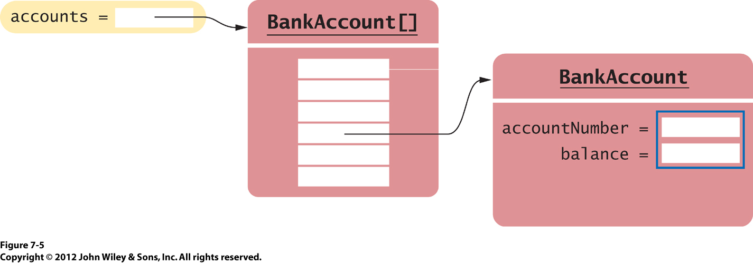
Fig_7-5
Like ArrayLists, Arrays can hold references to Objects…

Slide 8
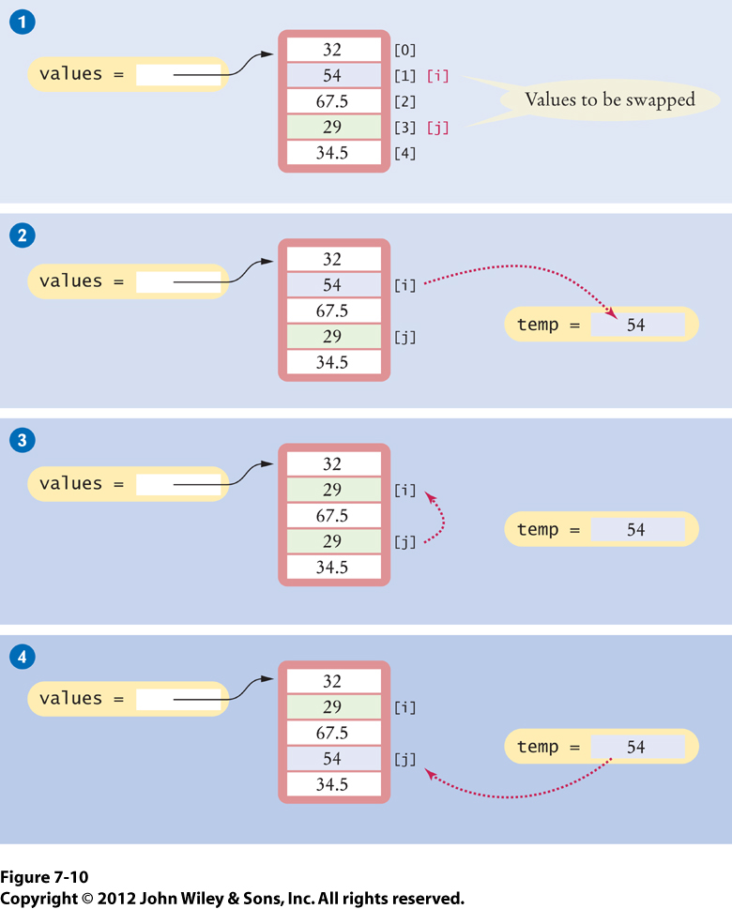
Fig_7-10
Swapping of array elements is needed when sorting an array…

Slide 9
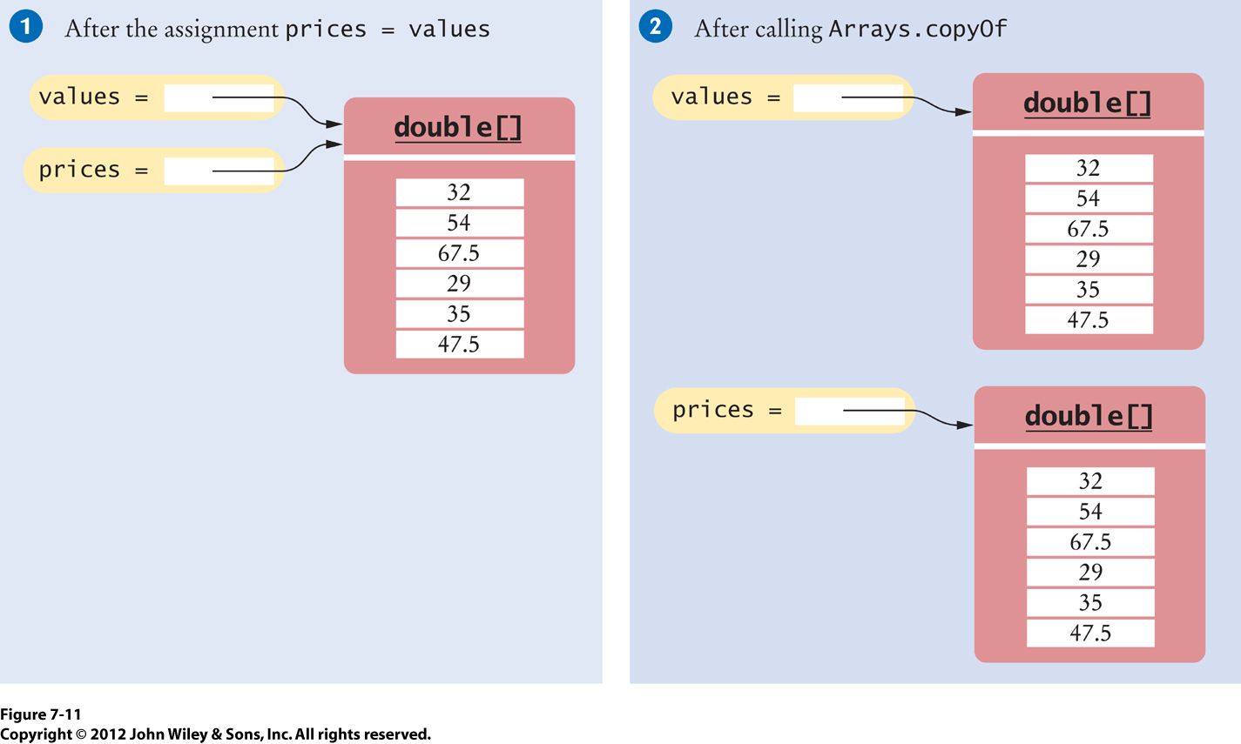
Fig_7-11
There IS a difference between 2 reference variables pointing to same array, and making a physical copy of the array…

Slide 10
What changes would you need to make to convert the BFF arrayList into an array.
How does the definition of the array change?
How do you add to an array? What role does the currentSize variable play?
How do you remove from an array?
How do you change an element of an array?
How do you display 1 element in an array?
How do you display the entire array?
How do you prevent a null pointer error with arrays?

Slide 11
2-D Arrays

Slide 12
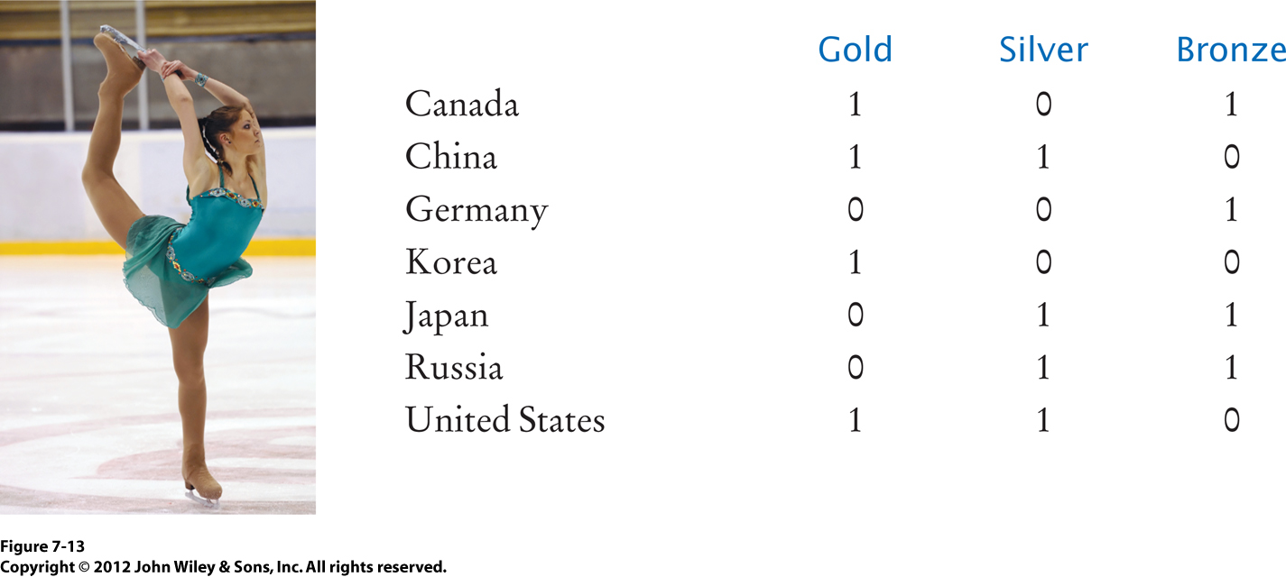
Fig_7-13

Slide 13
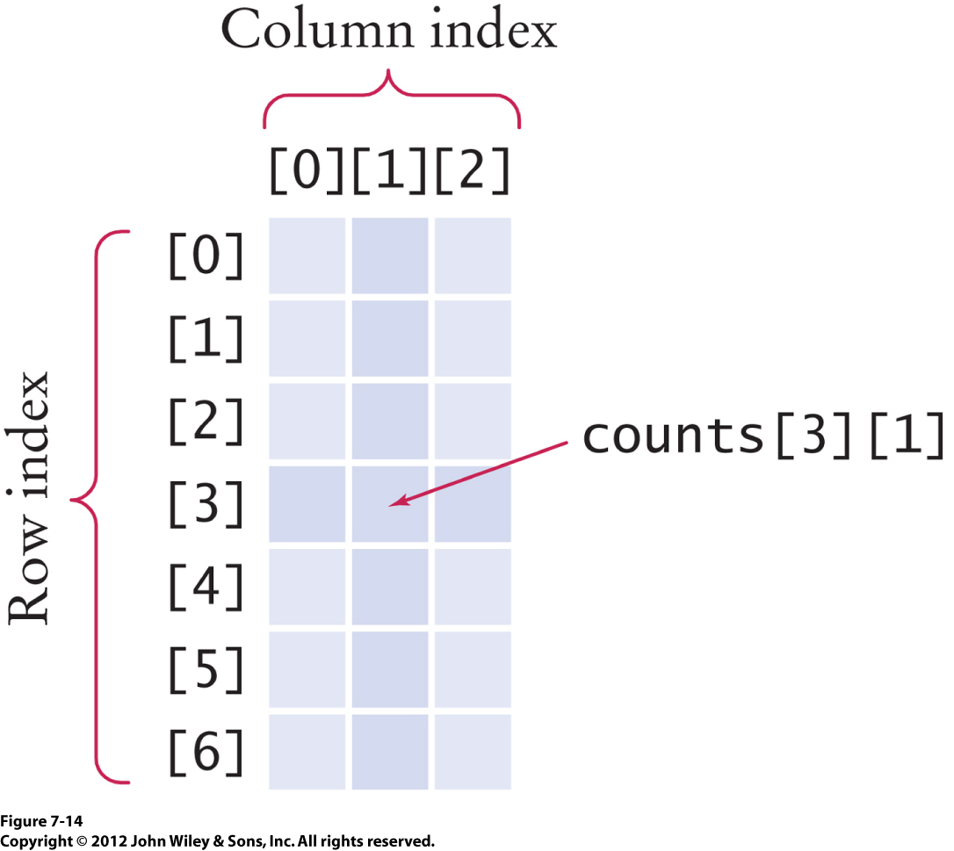
Fig_7-14

Slide 14
Declaring 2-D Arrays
int[][] counts = new int[rowSize][colSize]; counts[0][0] = ….; counts[0][1] = ….; …. (or use a loop, and either read a file, or get user input to populate each element) OR… int[][] counts = { {1, 0 , 0}, {1, 1, 0}, …. }
As many {} as there are rows in 2-D array

Slide 15
Accessing 2-D Arrays
Use a Nested For-Loop: for (int i = 0; i < rowSize; i++) { for (int j = 0; j < colSize; j++) { System.out.println(counts[i][j]); //manipulate each element in 2-D array } }

Slide 16
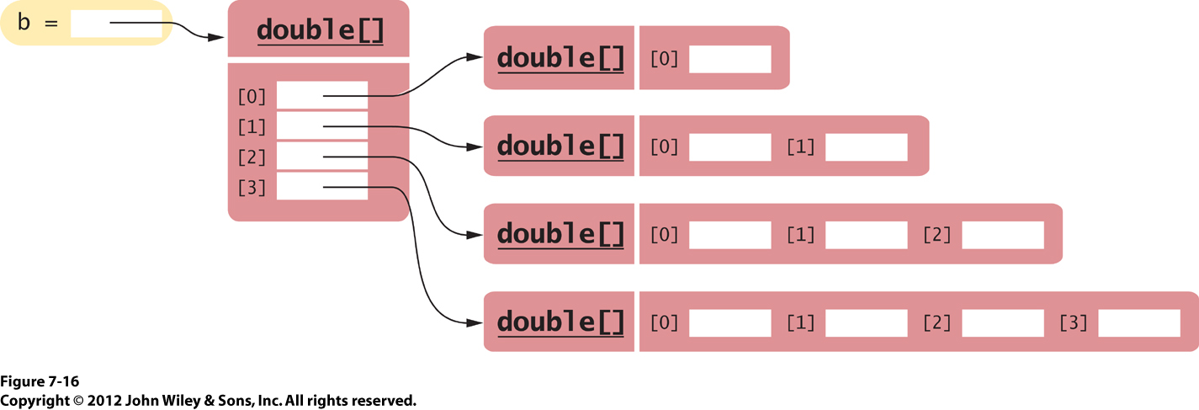
Fig_7-16
Example: double [][] b = new double[3][]; //leave second array index empty, indicating you will manually set each row. Then, allocate each row separately: for (int I = 0; I < b.length; i++) { b[i] = new double[i + 1]; }

Slide 17
Review
Download the WorldPopulation.zip file, and look at the 2-D array
Explain each of the nested for-loops
Why is there a separate array for the country names?
What is the difference between printf and print?

Slide 18
Fig_7-15
In Class Activity
Define a 2-D array of 5 rows and 3 columns, and initialize it with int values that represent the number of gold, silver, and bronze medals that were won by each country.
Define a 1-D array of 5 rows, and initialize it with String values that represent the following 5 countries: Canada, China, Germany, Korea, Japan, Russia, and US
Write a nested for-loop that will go through each row, and add the medal count in each row.
Once all the medals are added up, display the country name (using the parallel Country array) and the sum of medals won by that country.
At the end of the 2-D array, display the total of all medals won by the 5 countries..

Slide 19
Optional…
Battleship!
See next couple of slides…

Slide 20
Active Learning Activity – Battleship!
With your pair programming partner and table team, design a 2-D array of 5 rows and 5 columns.
Divide your table team so that each pair programming team designs (pseudo code) according to the NEW rules of Battleship (see next slide).
Create “method stubs” for the missing methods, and test your own method with hardcoded values returned from the method stubs.
As each pair programming team finishes testing their method, add the method to your program, and re-test.
Don’t forget to validate the user’s input.
Continue this process until entire table has tested entire program. Good luck!

Slide 21
Battleship – New Rules…
Suggested Game:
1.) Create a 5 x 5 board and initialize it to all 0's. 2.) Then, the computer randomly generates 8 locations (row & col) to place 8 battleships (unknown to player). Hint: random numbers 0 - 4 for rows and columns Designate the battleship location with a 1 on the 5 x 5 board. 3.) Player gets 12 chances to guess the location of the ships. User will be prompted to enter a row and a column where the battleship may be found. 4.) Computer tracks the Misses, the Hits, and the Original Board. 5.) After every player's guess, the computer will validate the guess (valid row and valid column number), and will display the battleship board.
6.) Every time the player guesses the location of a battleship correctly, he/she gets 1 extra chance to guess (or they don't lose their current chance) 7.) After 0 chances left, the game will end, saying how many misses and how many hits the player got. 8.) If the player gets all the battleships, the message "war is won!" is printed 9.) Extra Credit: Computer asks if the user wants to play again, and if so, clears the board, and goes back to step 2

